Slide 1
Data Center Security Fundamental

Slide 2
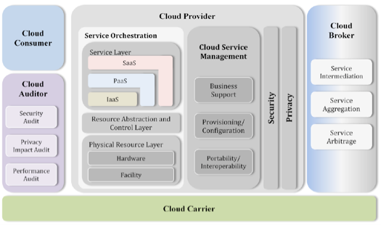
Cloud Computing Overview

Slide 3
CLOUD COMPUTING ROLES
Cloud Customers
An individual or entity that utilizes or subscribes to cloud-based services or resources.
Cloud Service Provider CSP
A company that provides cloud-based platform, infrastructure, application, or storage service to other organization and/or individuals, usually for a fee, otherwise known to client “As a Service”
Cloud Computing Reseller
A cloud computing reseller is a company that purchases hosting services from a cloud server hosting or cloud computing provider and then re-sells them to its own customers. E.g. Ingram Mico,Web5

Slide 4
CLOUD COMPUTING ROLES
Cloud Backup Service Provider: A third-party entity that mange holds operational responsibilities for cloud-based data backup service and solutions to customers from a central data center.
Cloud Service Broker (CSB): acts as liaison between cloud service customers and cloud service providers
Cloud Service Auditor: Third party organization that verifies attainment of SLAs.
Cloud Carrier: The intermediary that provides connectivity and transport of Cloud Services between Cloud Providers and Cloud Consumers. Provides access to cloud consumers through network, telecommunication and other access devices.

Slide 5
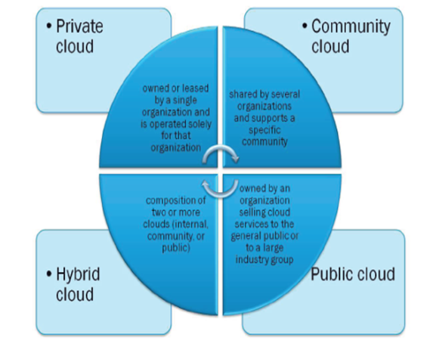
Cloud Deployment Models

Slide 6
Topice-3: Understand Security Concepts Relevant to Cloud Computing
Network Perimeter
Cryptography
Access Control
Data and Media Sanitization
Virtualization Security

Slide 7
Network Perimeter
For many cloud networks e.g. private cloud, the perimeter is clearly the demarcation point
For other cloud networks, the perimeter transforms into a series of highly dynamic “micro-border” around individual customer solutions or services
In other cloud networks, there is no clear perimeter at all.
The classic definition of a network perimeter takes on different meanings under different guises and deployment models

Slide 8
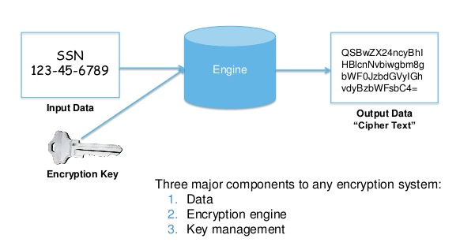
What is Encryption

Slide 9
Data in Transit
Information or data while in transmission across systems and components
Where information is crossing or traversing trusted and untrusted networks, the opportunity for interception, sniffing, or unauthorized access is heightened.
Example
TLS (Transport layer security protocol) provides a transport layer encrypted “TUNNEL” between email server or mail transfer agents (MTAs)
SSL (Secure Socket layer) certificates encrypt private communication over the internet using private and public keys

Slide 10
Data at Rest
Data at Rest focuses on information or data while stagnant or at rest (typically not in use) within systems, networks, or storage volumes
When data is at rest, appropriate and suitable security controls need to be applied to ensure the ongoing confidentiality and integrity of information.

Slide 11
Importance of Key Management
Remove the dependency or assumption that the cloud provider is handing the encryption process and controls correctly.
Key Management should be separated from the provider hosting the data, and the data owner should be positioned to make decisions.

Slide 12
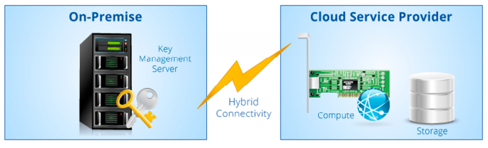
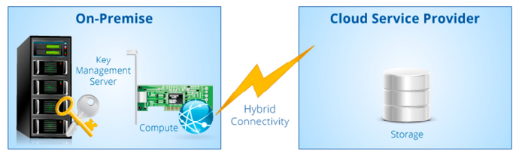
Remote Key Management Service
Customers own, maintain and support their own KMS, leaving the ownership and control to the customer while the hosting and the processing are sourced out to the cloud provider. Often the KMS uses an HSM for key generation and protection. This arrangement requires hybrid connectivity between the cloud provider and the On-Premise KMS. An application runs in the cloud provider’s compute virtual machines and makes calls to the customer’s HSM. The cloud provider can then upload encrypted content to cloud storage and later pull that encrypted content for computation which requires access to the on-premise KMS.
Client Side Key Management System
In CKMS, customer is in complete control of encryption/decryption keys. As shown in Fig, almost all processing and control is done on the customer side. The cloud provider does not hold keys, has minimal knowledge of users, cannot decrypt customer data, and facilitates the storage of encrypted data. The KMS is provided and run by the cloud provider, but the KMS resides on customer’s premise and the keys are generated and held by the customer. This type of solution can be used by cloud storage and SaaS providers.

Slide 13
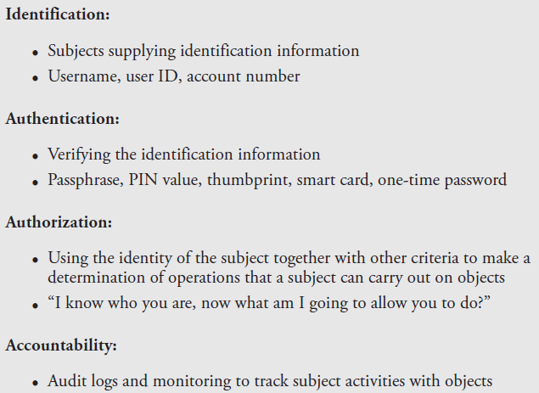
Elements of Access Control

Slide 14
Understand Security Concepts Relevant to Cloud Computing
Common Threats
Security Considerations for Different Cloud Categories.

Slide 15

The Notorious Nine :Top Threats in 2013
To identify the top threats, CSA conducted a survey of industry experts to compile professional opinion on the greatest vulnerabilities within cloud computing. The Top Threats working group used these survey results alongside their expertise to craft the final 2013 report ranked in order of severity:
Data Breaches
Data Loss
Account Hijacking
Insecure API
Denial of Service
Malicious Insiders
Abuse of Cloud Services
Insufficient Due Diligence
Shared Technology Issues

Slide 16
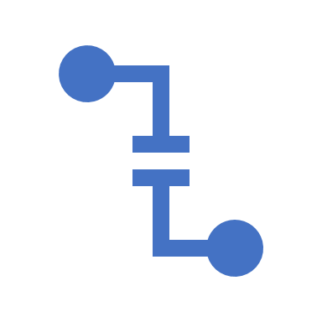
Threat #1: Data Breach
In simple terms data breach is a situation where the data is accessed by someone who is not supposed to have access to it in the first place. How safe is your data in cloud . For example, if a multitenant cloud service database is not properly designed, a flaw in one client’s application could allow an attacker access not only to that client’s data, but every other client’s data as well.
Threat #2: Data loss
Data Loss on the other hand can happen both intentionally or accidentally. For example, you may fail to notice that your backup process is failing and one fine day your system could crash taking away the data with it.
Threat #3: Account/Service Traffic Hijacking
Attack methods such as phishing, fraud, and exploitation of software vulnerabilities still achieve results. Cloud solutions add a new threat to the landscape. If an attacker gains access to your credentials, they can eavesdrop on your activities and transactions, manipulate data, return falsified information, and redirect your clients to illegitimate sites.

Slide 17
Threat #4: Insecure APIs
Cloud computing providers expose a set of software interfaces or APIs that customers use to manage and interact with cloud services. Provisioning, management, orchestration, and monitoring are all performed using these interfaces. The security and availability of general cloud services is dependent upon the security of these basic APIs.
Threat #5: Denial of Service
denial-of-service attacks are attacks meant to prevent users of a cloud service from being able to access their data or their applications. Asymmetric application-level DoS attacks take advantage of vulnerabilities in web servers, databases, or other cloud resources, allowing a malicious individual to take out an application using a single extremely small attack payload – in some cases less than 100 bytes long.
Threat #6: Malicious Insiders
A malicious insider threat to an organization is a current or former employee, contractor, or other business partner who has or had authorized access to an organization’s network, system, or data and intentionally exceeded or misused that access in a manner that negatively affected the confidentiality, integrity, or availability of the organization’s information or information systems.

Slide 18
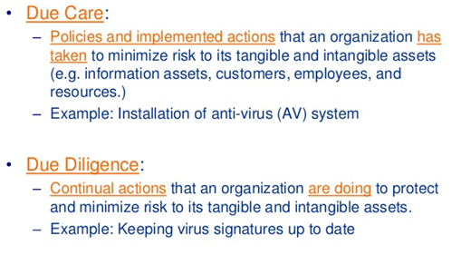
Threat #7: Abuse of cloud services We know that cloud computing brings large scale, elastic services offering enormous computing power at an extremely lower cost. This is also equally applicable for hackers. Hackers needed huge computing power to crack things, but they were not able to afford it. With cloud what used to take a year with home machines, can now be done in hours on cloud.
Threat #8: Insufficient Due Diligence
Threat #9: Shared Technology Vulnerabilities
Some of the SaaS solutions, particularly legacy ones are delivered using virtualization. We all know virtualization works under the concept of multi-tenancy, where the machine is sliced to serve multiple customers. In such scenarios, any compromise at the hypervisor level can lead to severe breaches.

Slide 19
Infrastructure as a Service (IaaS) Security
Virtual Machine Attacks
Virtual Network
Hypervisor Attacks -Hyperjackig
vSwtich Attacks
Denial-of-Service (DoS) Attacks
Co-location

Slide 20
Platform as a Service (PaaS) Security
System/Resource Isolation
User Level Permissions
User Access Management
Protection Against (Malware / Backdoors / Trojans)

Slide 21

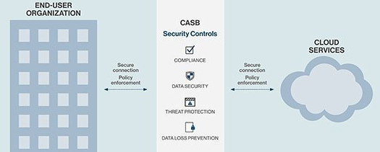
Software as a Service (SaaS) Security
Data Segregation
As a result of multi-tenancy, multiple users can store their data using applications provided by SaaS.
A SaaS model should therefore ensure a clear segregation for each user’s data
Data Access and Policies
The key challenge is to map existing security policy, process, and standard to meet and match policies that CSP enforces.
A cloud access security broker (CASB) is an on-premises or cloud-based security policy enforcement point that is placed between cloud service consumers and cloud service providers to combine and interject enterprise security policies as cloud-based resources are accessed e.g. cisco cloudlock, netskope
Repeated assessments of the security policies for accessing data.

Slide 22
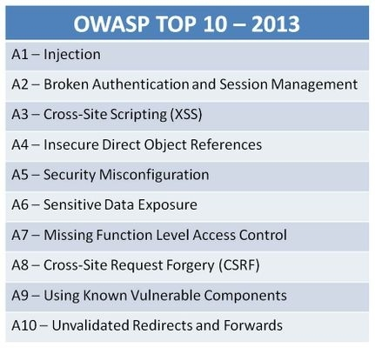
Web Application Security

Slide 23
Important SLA Components
Single Points of Failure should not exist
Migration to alternate provider(s) should be possible within the agreed upon RTO
Whether all components will be supported by alternate cloud providers in the event of a failover.
Automated controls should be enabled to allow customers to verify data integrity
Where data backups are included, incremental backups should allow the user to select the desired settings
Regular assessment of SLA.

Slide 24
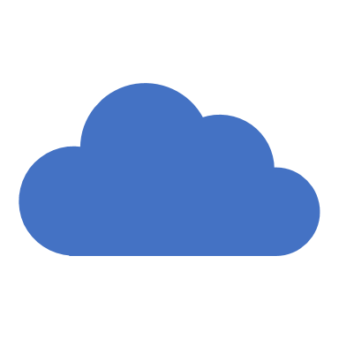
Cloud Data Security

Slide 25
Cloud Data Security
Cloud Data Lifecycle
Design & Implement Cloud data storage architecture
Design and apply Data Security Strategies
Data Discovery and Classification Techniques
Relevant Jurisdictional Data protection for Personally Identifiable Information (PII)
Data Rights Management
Data retention , Deletion and Archiving Policy
Auditability , Traceability, and Accountability of Data Events

Slide 26
Topic-1: Cloud Data Life Cycle (CSUSAD)
Create: is the generation of new digital content, or the alteration/updating/modifying of existing content,
1
Store: is the act committing the digital data to some sort of storage repository and typically occurs nearly simultaneously with creation.
2
Use: Data is viewed, processed, or otherwise used in some sort of activity, not including modification.
3
Share: Information is made accessible to others, such as between users, to customers, and to partners.
4
Archive: Data leaves active use and enters long-term storage.
5
Destroy: Data is permanently destroyed using physical or digital means [e.g., crypto shredding).
6

Slide 27
Topic-2: Design and Implement Cloud Data Storage Architectures
•Storage Types
•Threats to Storage Types
•Technologies Available to Address Threats

Slide 28
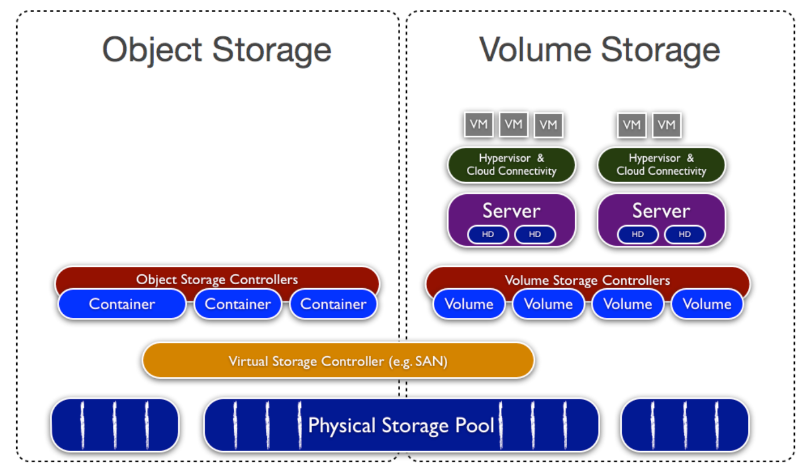
IaaS Storage Types

Slide 29
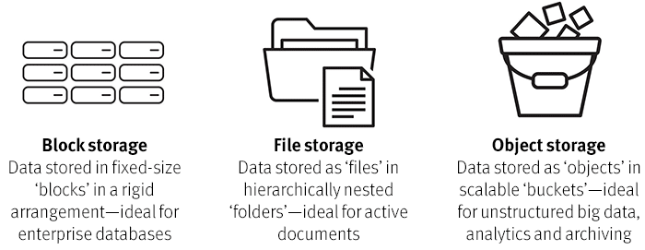
Volume storage Types
1. File Storage
The data is stored and displayed just as with a file structure in the legacy environment, as files and folders, with all the same hierarchical and naming functions. File level storage is usually accessible using common file level protocols such as SMB/CIFS (Windows) and NFS (Linux, VMware).
2. Block Storage
Whereas file storage has a hierarchy of folders and files, block storage is a blank volume that the customer or user can put anything into. Block storage might allow more flexibility and higher performance, but it requires a greater amount of administration and might entail installation of an OS or other app to store, sort, and retrieve the data.
Block storage is usable for almost any kind of application, including file storage, database storage, virtual machine file system (VMFS) volumes, enterprise backup services etc.

Slide 30
PaaS Storage Types
Used for application and other development while providing cloud components to software.
PaaS utilizes the following data storage types:
Structured: Information with a high degree of organization, such that inclusion in a relational database is seamless and readily searchable by simple, straightforward search engine algorithms or other search operations.
Unstructured: Information that does not reside in a traditional row-column database. Unstructured data files often include text and multimedia content. Examples include email messages, word processing documents, videos, photos, audio files, presentations, web pages, and many other kinds of business documents.

Slide 31
SaaS Storage Types
Use the web to deliver applications that are managed by a third-party vendor and whose interface is accessed on the client’s side.
SaaS utilized the following data storage types:
Information storage management
Content/File Storage

Slide 32
Threat to Storage
Unauthorized use or access
Liability due to regulatory non-compliance
Denial of Service (DoS) and Distributed DoS attack on storage
Corruption/modification and destruction of data
Data leakage/breaches
Theft or accidental loss of media
Malware attacks or introduction
Improper treatment or sanitization after end-of –use.

Slide 33
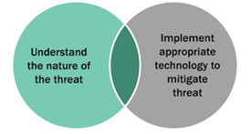
Technologies to Address Threats

Slide 34
Data Security Strategies
1. Understand data type
2. Understand data structure & format
3. Understand cloud service module
4. Understand cloud storage options
5. Understand CSP data residency offering
6. Plan data discovery & classification
7. Define data ownership
8. Plan protection of data controls 9. Plan for ongoing monitoring

Slide 35
Cloud Platform and Infrastructure Security

Slide 36
Topic-1: Risk Associated to Cloud Infrastructure
Risk Assessment/Analysis
Virtualization Risks
Cloud Attack Vectors
Counter –Measure Strategies

Slide 37
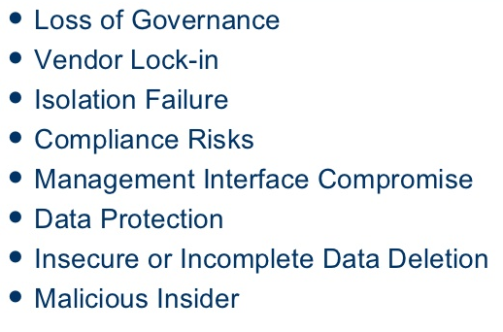
ENISA
ENISA (European Network and Information Security Agency) is responsible for producing Cloud Computing: Benefits, Risks, and Recommendations for Information Security. It identifies the top eight security risks based on likelihood and impact.

Slide 38
Virtualization Risks
Guest /VM escape
Snapshot and image security
Sprawl

Slide 39
Cloud Specific Risks
Management plane breach
Resource exhaustion
Isolation control failure
Insecure or incomplete data deletion
Control conflict risk
Software-related risk

Slide 40
Legal Risk
Law enforcement
Jurisdiction
Data Protection
Licensing

Slide 41
Non-Cloud Specific Risks
Natural disasters
Unauthorized facility access
Social engineering
Network attacks on the consumer & provider
Default password
Other malicious or non malicious risks

Slide 42
Cloud Attack Vectors
Guest escape
Identity compromise, either technical or social
API compromise
Attacks on the provider’s infrastructure and facilities
Attacks on the connecting infrastructure

Slide 43
Access Controls
Building access
Access to building facilities
Computer floor access
Cage or rack access
Access to physical server
Hypervisor access (API or management plane)
Guest system access
Database access rights

Slide 44
Topic -2: Design and Plan Security Controls
1. Physical and Environmental Protection
2. Virtualization Systems Control
3. Management of Identification, Authentication, and Authorization in Cloud Infrastructure
4. Audit Mechanisms

Slide 45

Physical and Environmental Protection
•The physical infrastructure and its environment consist of the data center, its buildings, and surroundings. Infrastructure outside the data center needs protection:
Network and communication facilities
Endpoint such as PCs, laptops, mobile phones, and other smart devices
•Well-established bodies of knowledge around physical security : NIST’s SP 800-14 and SP 800-123

Slide 46
Virtualization Systems Control
•Virtualization components include compute, storage, and network
•Management plane controls the entire infrastructure (Is a primary resource to protect). Its GUI, command-line interface (CLI, if any), and APIs all need to have stringent and role-based access controls (RBACs) applied.
•These components need to be hardened to the highest relevant standards by following vendor hardening and security guides, including malware detection and patch management.
• When other controls are not strong , Trust zones segregate the physical infrastructure.

Slide 47
Virtualization infrastructure Controls
The virtualization infrastructure should enable the tenants to implement the appropriate security controls :
Traffic isolation by using VLAN, transmission encryption.
Guest security. This can be in the scope of the PaaS provider
File and Volume encryption.
Control of image life cycle: image creation, distribution, storage, use, retirement, and destruction

Slide 48
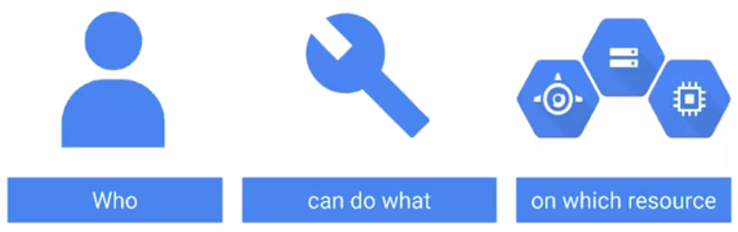
IAM
•Identity and Access Management (IAM) includes people, processes, and systems that are used to manage access to enterprise resources
•This is achieved by:
Assuring that the identity of an entity is verified (who are they, can they prove who are they)
Granting the correct assets, services and accessed.

Slide 49
SSO
SSO is an umbrella term for any time a user can login to multiple applications while only authenticating once. It covers :
1. Federation
2. Password vaulting or “Enterprise SSO”.
The main difference is that federation eliminates the requirement to use and remember passwords and Enterprise SSO doesn’t.

Slide 50
Federation
•Federation is an association of organizations that come together to exchange information as appropriate about their users and resources to enable collaborations and transactions.
•Federation allows single sign-on (SSO) without passwords – the federation identity server knows the username for a Person in each application and presents that application with a token that says, " this person is domain\ngupta or ngupta@example.com". No password is required for the user to login to each system.
•The federation identity server passes that token using one of the standard identity protocols: SAML, OpenID, WS-Trust, WS-Federation and OAuth. .

Slide 51

Enterprise SSO
When the applications still require that a password be sent to login, but the software handles storing it and automatically retrieving it for the user and inputting it into the application for an automatic login. The user still has a password for each system that must be provided to login, must be changed on a regular basis, etc.

Slide 52
Federation Standards
•SAML
•WS-Federation
•Oauth
•Open ID Connect

Slide 53
Multi-factor Authentication
•Add an extra level of protection to verify the legitimacy of a transaction
•To be a Multi-factor system, users must be able to provide at least two of the following requirements:
-What they know (e.g. password)
-What they have (e.g., display token with random numbers displayed)
-What they are (e.g., biometrics)
•One-time passwords also fall under the banner of multi-factor authentication

Slide 54
Support the Planning Process for the Data Center Design
1. Logical
1
2. Physical Design
2
3. Environmental Design
3

Slide 55
Factors That Impact Data Center Design
1. The location of the data center and users of the cloud affect compliance decisions
2. Contingency, failover, and redundancy
3. They type of service (PaaS, IaaS, SaaS) the cloud will provide
4. Operating standards e.g. ISO 27001 / ITIL-ITSM

Slide 56
Logical Design : Multi-tenancy
•Multi-tenant networks, in a nutshell, are datacenter network that are logically divided into smaller, isolated networks.
•They share the physical network gear but operate on their own network without visibility into the other logical networks
• The multi-tenant nature of cloud deployment requires logical design that partition and segregated client/customer data.
• Failure to do so can result in the unauthorized access, viewing or modification of tenant data.

Slide 57
Cloud Management Plane
The cloud management plane needs to be logically isolated although physical isolation may offer a more secure solution. The cloud management plane provides monitoring and administration of the cloud network platform to keep the whole cloud operating normally

Slide 58
Logical Design Levels
Logical design for data separation need to be incorporated at the following levels:
•Compute nodes
•Management plane
•Storage Nodes
•Control plane
•Network

Slide 59
Physical Design Considerations
Does the physical design protect against environmental threats for the location such as flooding, earthquakes, and storms?
Does the physical design include provision for access to resources during disasters to ensure the data center and its personnel can continue to operate safely?
Example include,
Clean water, clean power, Food, Telecommunications, Accessibility during/after a disaster
Physical security design features that limit access to authorized personnel.
Perimeter protection such as walls, fences, gates, electronic surveillance.
Access points to control ingress and egress and verify identify and access authorization with an audit trail; this include egress monitoring to prevent theft.

Slide 60
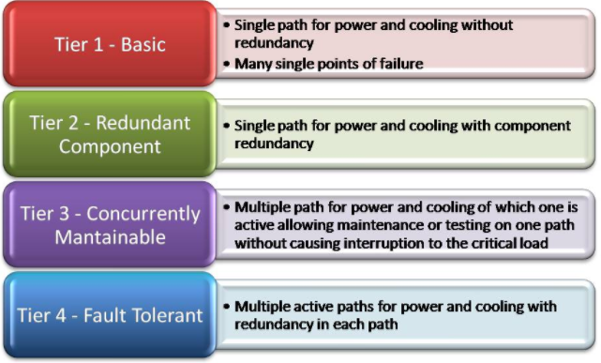
Tier Standard Levels

Slide 61
Environmental Design
The environmental design must account for:
1. Adequate heating
2. Ventilation
3. Air conditioning
4. Power with adequate conditioning
5. Adequate Backup of power & cooling

Slide 62
Run Physical Infrastructure for Cloud Environment
Module Topics
Configure Access Control for Cloud Hosting
Secure Network Configuration
Availability of Stand-alone Hosts
Availability of Clustered Hosts

Slide 63
Secure KVM (Keyboard , Video, Mouse) Design Criteria
•Isolated data channels: Located in each KVM port, these make it impossible for data to be transferred between connected computers through the KVM.
•Tamper-warning labels on each side of the KVM: These provide clear visual evidence if the enclosure has been compromised.
.Housing intrusion detection: This causes the KVM to become inoperable and the LEDs to flash repeatedly if the housing has been opened.
•Fixed firmware: It cannot be reprogrammed, preventing attempts to alter the logic of the KVM.

Slide 64
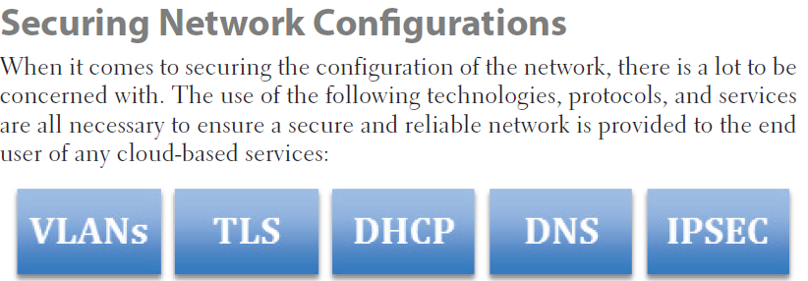
Cloud network security

Slide 65
Network Isolation
•Isolation is a critical design concept for a secure network configuration in cloud environment.
•Customer Access should be provisioned on isolated networks. This can be implemented through the use of physically separate networks or via VLAN’s.

